Slide 1
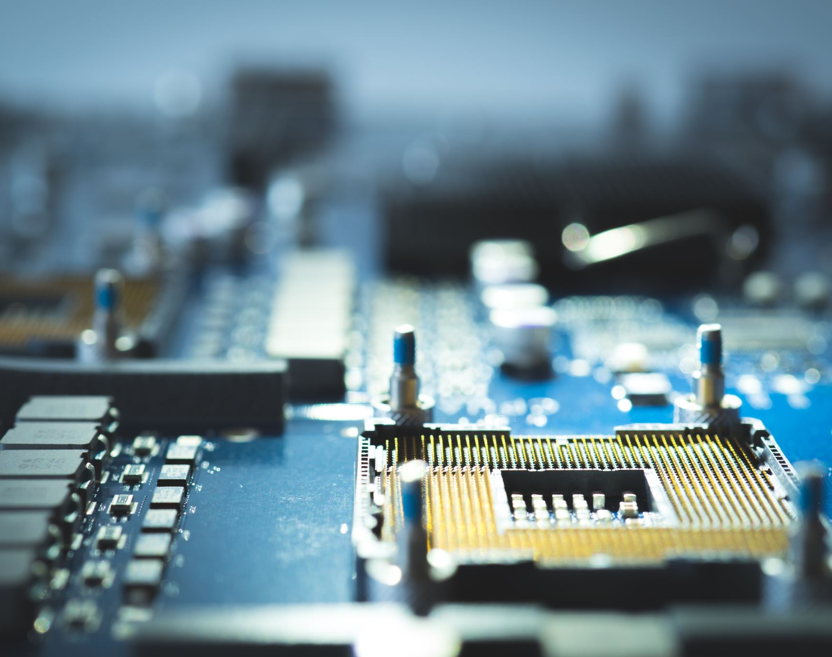

3rd and 4th Generation Computers
txx
Wathila (Leader) - 20220955
Senudi b - 20220941
Pahanmi - 20220931
Steve - 20221633
Gerald - 20221108
Edith b - 20220980
Thulaxsiga - 20221638
DOC314 Digital Skills For Higher Education

Slide 2


INTRODUCTION
20220955
Today, We are Here To Present About 3rd and 4th Generation Of computers
Generation | Year | Technology
1st Generation | 1940 - 1950 | Vacuum tube
2nd Generation | 1950 - 1960 | Transistor
3rd Generation | 1960 - 1970 | Integrated circuit
4th Generation | 1970 - present | Microprocessor
5th Generation | The present / future | Artificial intelligence
DOC314 Digital Skills For Higher Education

Slide 3
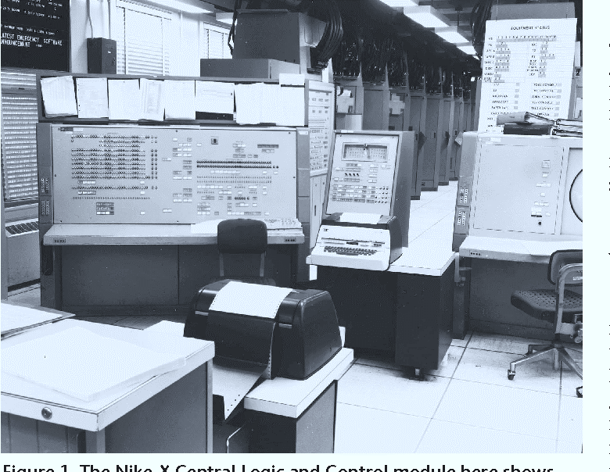
3rd Generation Computers (1960-1971)
txx
20220941
3rd Generation computers are between 1965 and ended around 1971
Third generation computers used Integrated Circuits instead of transistors.
Keyboard and mouse are used for data input.
It is smaller in size and produce less heat generation
Magnetic storage was introduced
> Hard disk, Floppy disk, Magnetic Tape
DOC314 Digital Skills For Higher Education

Slide 4

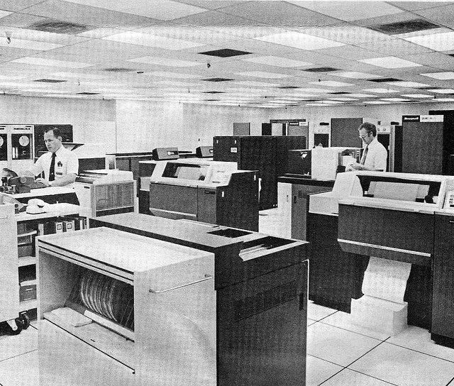
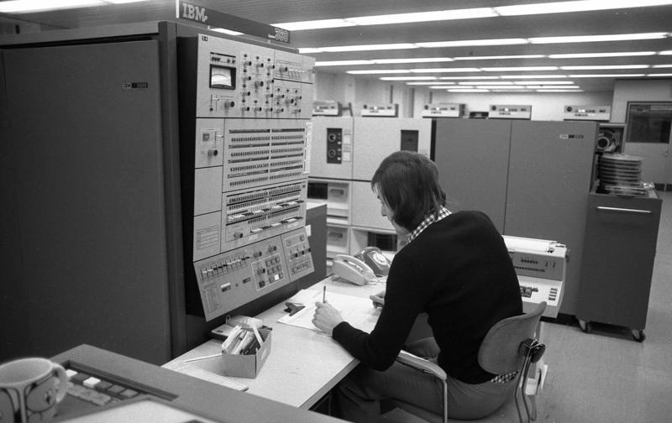
Examples for 3rd generation computers
20220941
IBM 360 - series
Honeywell 6000 series
IBM-370/168
TDC-316
PDP-8, PDP-11
Honeywell 6000 series
IBM 360 - series

Slide 5

Characteristics of 3rd generation computers
20220931
Transistors were replaced with IC’s
Fast and more reliable
High level language was developed
I/O devices became more sophisticated
Smaller in size and cheaper than 2nd generation computers

Slide 6
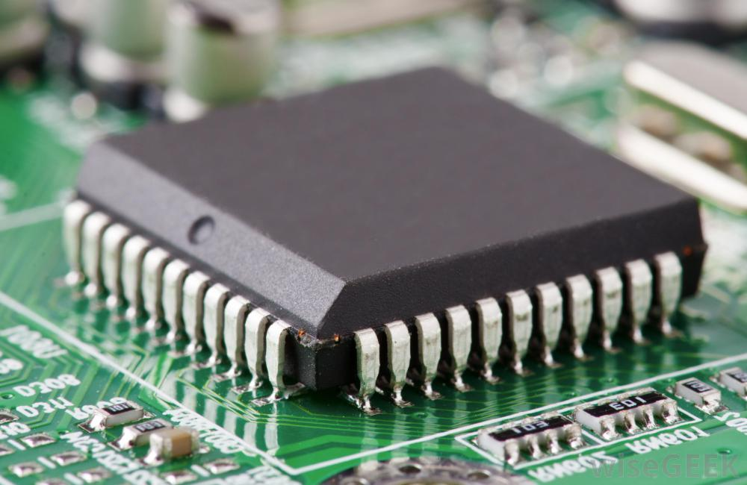
Integrated Circuits
20221633
IC was invented by Jack Kilby
First time electronic components integrated into single surface
IC can function as an amplifier, oscillator, timer, logic gate, microprocessor
A single IC consists thousands of
> registers, capacitors, and transistors
High-level languages Used are,
> Basic, Pascal, C++, Perl
DOC314 Digital Skills For Higher Education

Slide 7

Advantages And Disadvantages
20221633
Advantages | Disadvantages
Smaller in size | Manufacturing IC were difficult
Generates less heat | These computers became expensive
Used mouse and keyboard instead of punch cards | Integrated Circuits were very complicated and required specialized workers
DOC314 Digital Skills For Higher Education

Slide 8
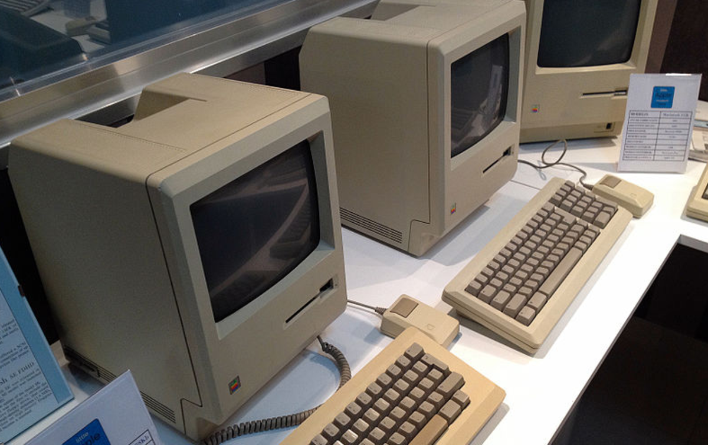
4th Generation Computers (1971-1980)
20221108
This generation used Very Large Scale Integrated (VLSI) circuits.
Thousands of IC are assembled on a single chip known as Silicon Chip
These computers were powerful, compact, reliable, and affordable and gave rise to Personal Computer (PC) revolution.
High level languages used,
> Python, C#, Java, JavaScript, Rust
DOC314 Digital Skills For Higher Education

Slide 9

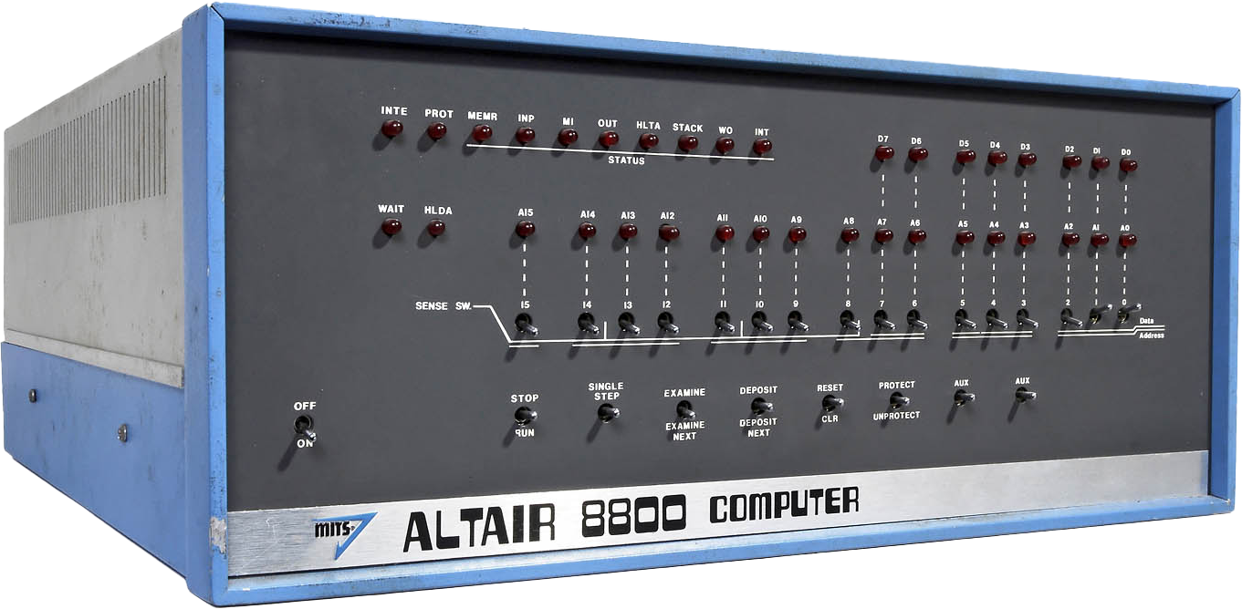
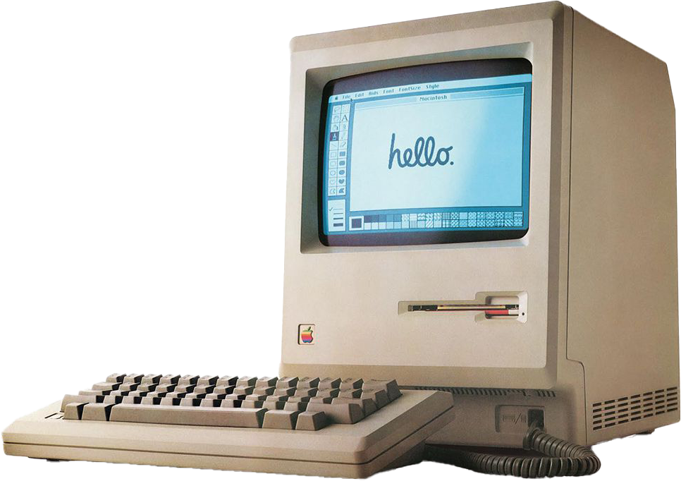
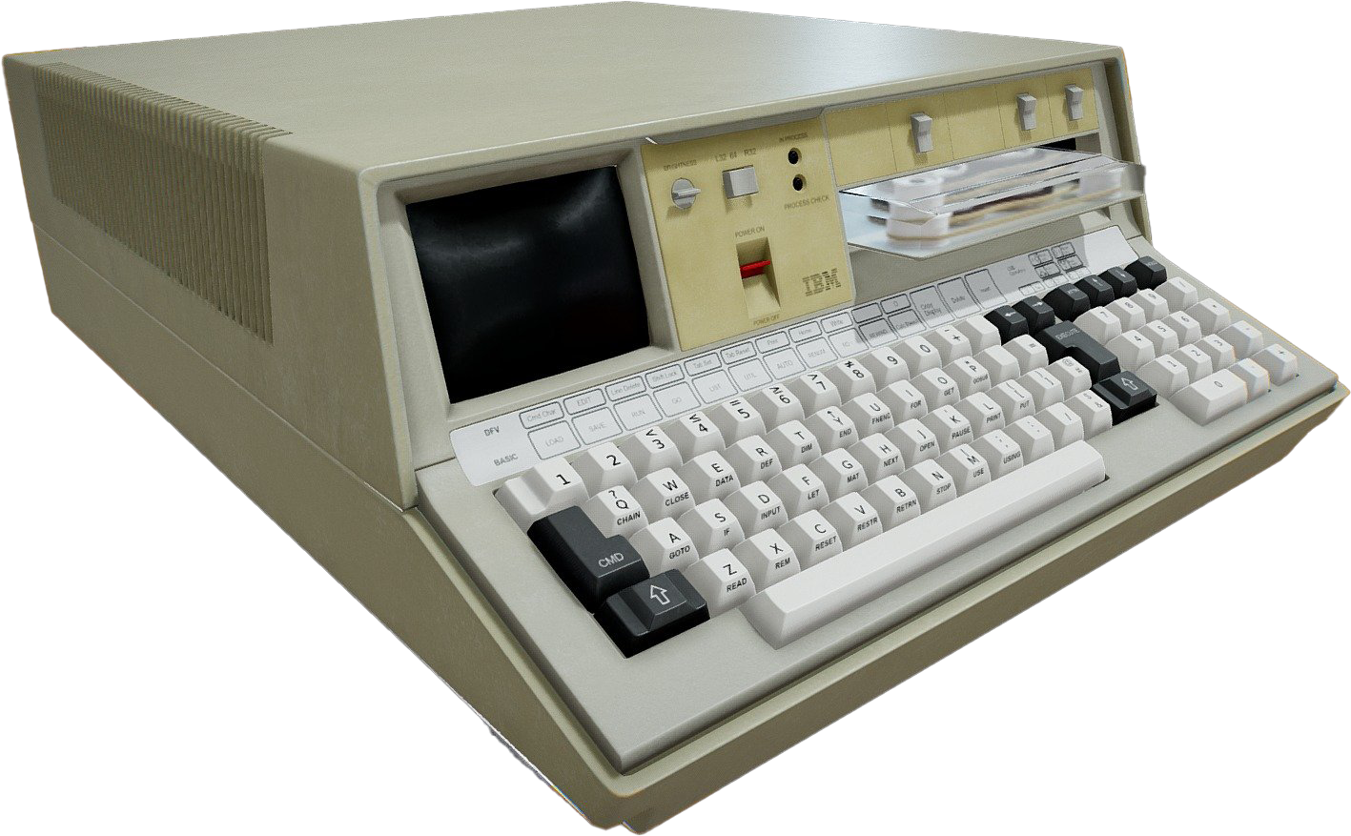
Examples for 4th generation computers
20221108
IBM 5100
Micral
Altair 8800
Apple 2
Altair 8800
Apple 2
IBM 5100

Slide 10

Characteristics of 4th generation computers
20220931
Creation of VLSI with help of many transistors
Became faster, reliable and small
Became cheaper than 3rd generation computers
High level programming language was more developed
OS with GUI began
DOC314 Digital Skills For Higher Education

Slide 11
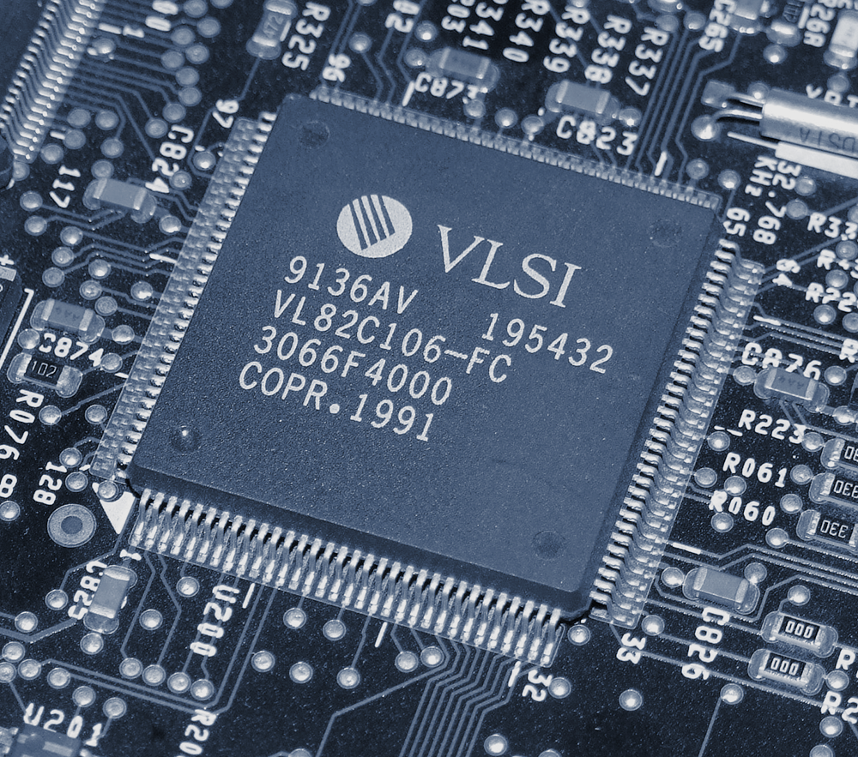
Very Large Scale Integration Circuits (VLSI)
20220980
Refers to devices based on transistors, diodes, resistances and capacitors assembled at very high densities
Requires less space ( fitting more transistor nodes on a smaller IC )
Increased cost-effectiveness for devices
Improved performance in terms of the operating speed of circuits
DOC314 Digital Skills For Higher Education

Slide 12


20220931
Advantages And Disadvantages
Advantages | Disadvantages
· More powerful and reliable | · Easily get virus
· Less hardware failure | · Only high skilled staff can manufacture
· Fast processing with less power | · Microprocessor use very high sophisticated technology
· The air conditioning system is not much needed and is more energy efficient than the before generation. | Design is very complex
DOC314 Digital Skills For Higher Education
DOC314 Digital Skills For Higher Education

Slide 13

Summary
20221638
In 3rd and 4th generation computers we can see a very huge development compared to 1st and 2nd generation computers.
These two generations use high level programming languages
Instead of vacuum tubes and transistors, microchips were used
Birth of OS occurred during these generations
Computers became faster and more reliable during these two generations
DOC314 Digital Skills For Higher Education

Slide 14


20221638
DOC314 Digital Skills For Higher Education

